Slide 1
Big Data Analytics and Application
Frederik Darwin
M10601836

Slide 2
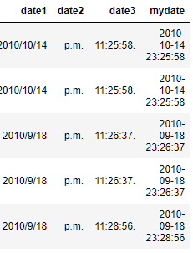
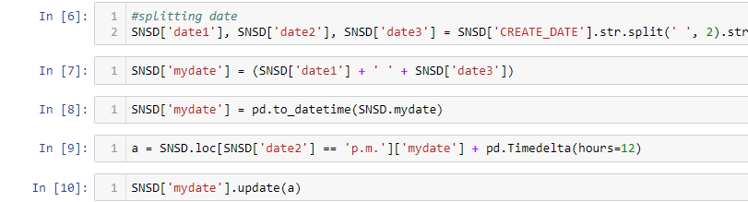
Preprocessing
Separating Data into two-parts: A for tickets with seat assignment and B for tickets with no seat assignment for 18 September 2010 only
Firstly I change the CREATE_DATE column just like the pdf provided for R, but I do It in python.
mydate created

Slide 3
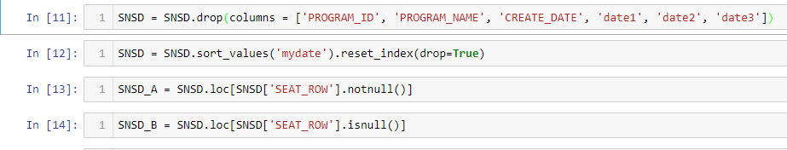
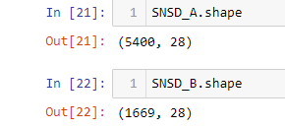
Preprocessing
Separate the data with seat assignment and no seat assignment (A and B) to SNSD_A and SNSD_B

Slide 4
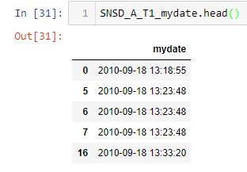
Preprocessing
Separate the data furthermore to T1 and T2, and only taking mydate column, because the objective is only ticket selling speed
Creating four of these kind of DataFrame in total

Slide 5
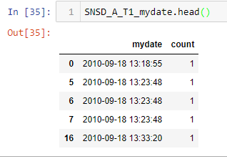
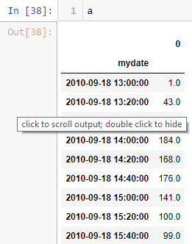

Analyzing the data
Before using the time series data to analyze the selling speed, I will add “count” column with value of 1, representing one ticket bought each time discrete before combining the timeframe to 20minute each
Combining the time frame by 20min each to analyze selling speed

Slide 6
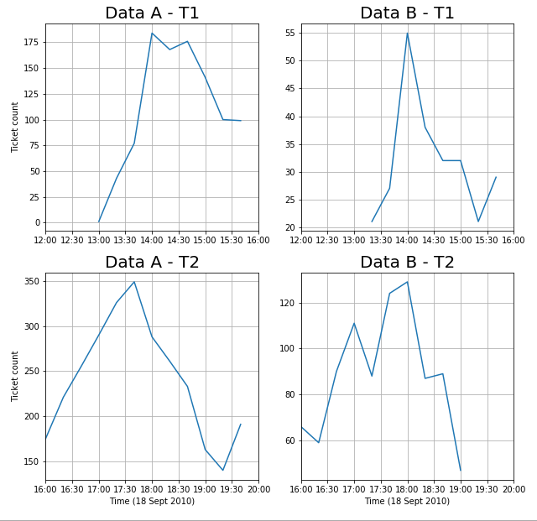
Plotting the data

Slide 7
Questions
In fact, the ticket selling of "Girl Generation 2010" concert was extremely busy on the first day of sale (Sept. 18 2010), and everybody tried to get the ticket right after the tickets started to sell at Sept. 18 noon. However, based on the data, do you find anything weird right after Sept. 18 2010 noon according to the statement above? Please show how fast the tickets were sold for A and B during T1 (12:00 -16:00 PM on Sept 18 2010) and T2 (during 16:00-20:00 Sept. 18 .2010) ? Please define your "ticket selling speed" and comparing it under A and B with these two time periods (T1 and T2).

Slide 8
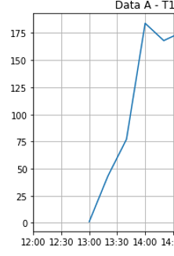
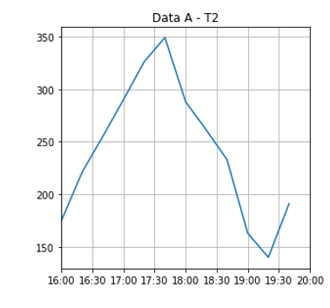
Questions
Looking from the plot created, we can see that there is no selling done from 12.00 to about 13.00. This data show us that probably the system broke on this time, so people can’t buy any tickets. The system is back online at 13.00, but only few people knew it. By the time everyone knew, at about 14.00, the system reached highest point of selling on both type of ticket. And this doesn’t stop, where the peak will be at around 18.00 where the selling count per 20 minutes is about 350 for A and 130 for B. People probably bought the ticket around this time because it’s the rush hour (the time people get off work).
No sell
Selling peak

Slide 9
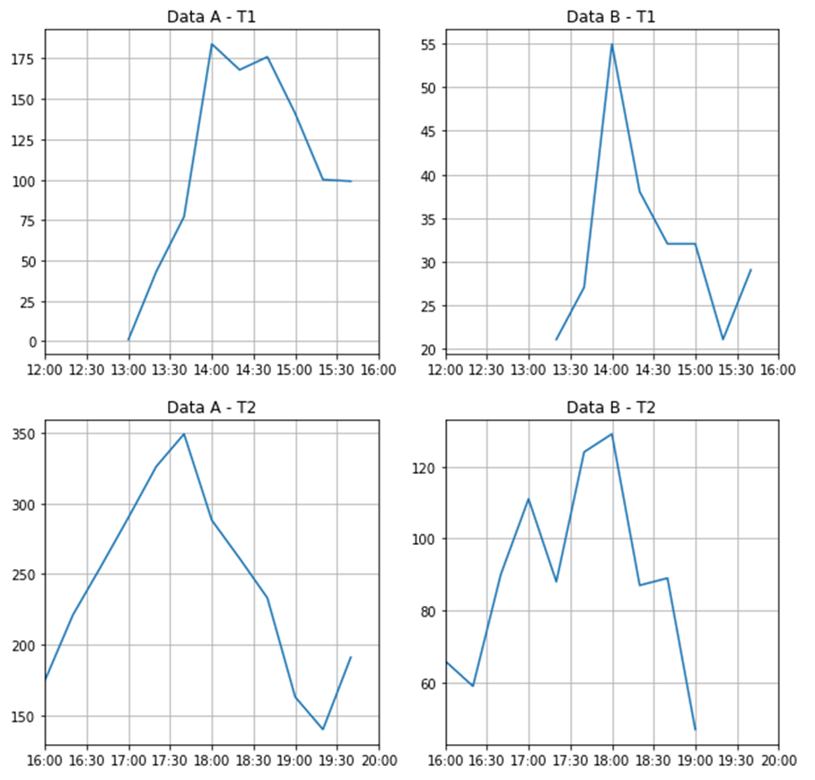
Questions
My defining of the selling speed will be just a simple one, tickets sold per hour per timeframe.
A_T1 = 247.25 tickets/hour
B_T1 = 63.75 tickets/hour
A_T2 = 723.0 tickets/hour
B_T2 = 222.5 tickets/hour
For T1 timeframe, the selling speed includes time for 12.00 – 13.00 despite no selling is happening

Slide 10


Questions
For ticket selling of B, if we assume everyone tried to get the B tickets during T1 (it was true at that time), can you define a new measurement to estimate the" system loading" (how busy the system is) during T1? And compare the " system loading" during T1 with it during T2? You might need to use the information of question #2 (above).
The data for both A and B peaked at around 180 and 55 for each ticket selling. If we assume that everyone tried to get B tickets during T1, we can assume that the upper bound for the system loading is 180+55, which is 235 tickets sold per 20min. Beyond this number, the system will broke.
But of course in reality it won’t be like that. If we assume that everyone will get B tickets which have no seat assignment, people’s session for buying ticket won’t be as long as when they need to pick which seat they want, especially if one people are buying tickets for his/her group which will need a lot of consideration which seat they will take. Just this particular example will create longer session and will contribute to the system load, breaking the system. I assume if everyone buys B ticket, it will have larger upper bound for the system, because each individual session is shorter.
The system loading for T2 is clearly higher than T1 where the highest selling count is 350 and around 130, which is around 480 tickets per 20min. This could be the real system load rather than the number that T1 have, since only few people logged in and bought ticket (it’s still work hours!). Or probably the ticketing system has been upgraded, or could be that each individual session has became more shorter than the previous timeframe. It’s already been hours since the tickets been sold. There could be people creating guide on his blog on how to buy the tickets, thus shortening the buying session for each individual, and raising the selling count.

